Slide 1

Home Assignment
Noam Bergman

Slide 2
Outline
Data examination
Solution approach
Block Diagram
The way to the results
Results: Curves
Confusion matrix, Specificity vs. Sensitivity, Accuracy
Analysis of FNs, FPs.
Visualization of computer features by PCA
Next steps
ViT summary

Slide 3
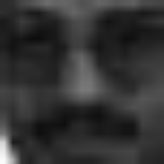
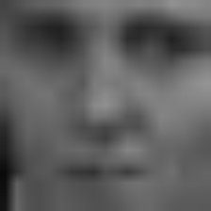
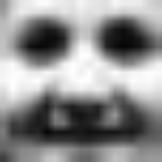
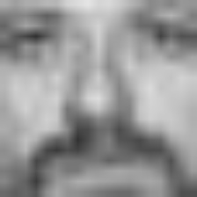
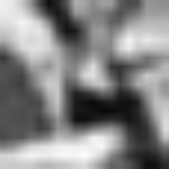
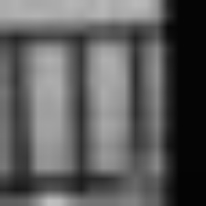
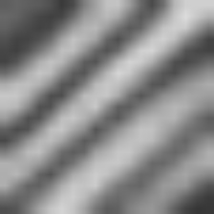
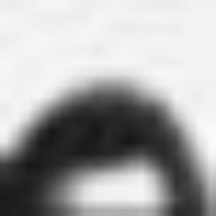
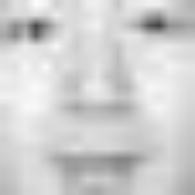
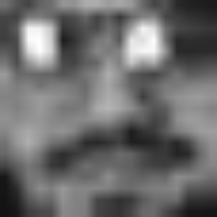
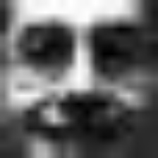
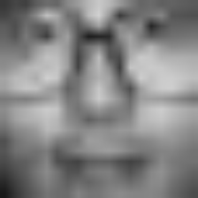
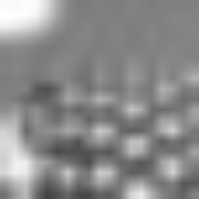
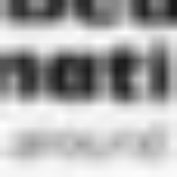
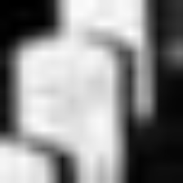
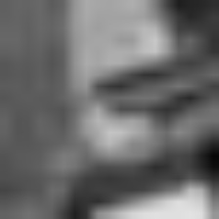
MIT Faces Dataset
Initial Steps:
Conversion to .jpg format.
Data inspection → both train and test set were resized to 224x224 for visual inspection.
CSV files were created with paths and labels.
Train set: 2429 faces (35%), 4548 non-faces (65%).
Test set: 472 faces (2%), 23573 non-faces (98%) → heavy imbalance.
Some positive examples from train set:
Some negative examples from train set:

Slide 4
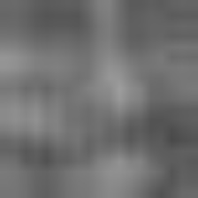
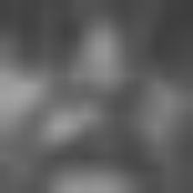
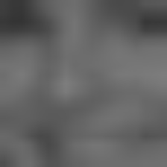
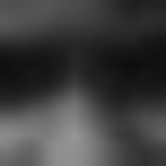
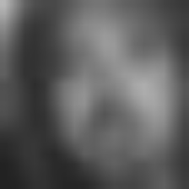
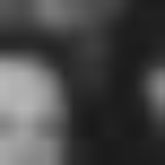
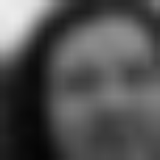
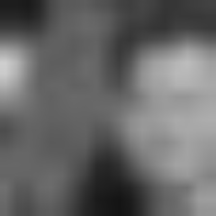
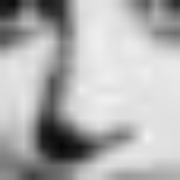

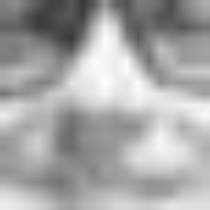
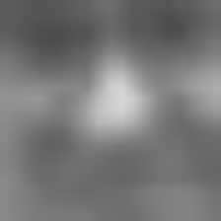
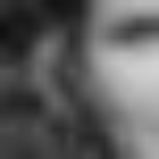
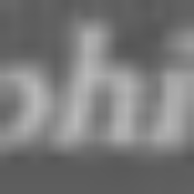
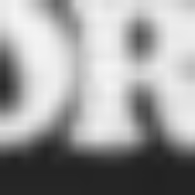
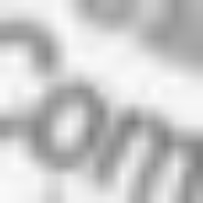
MIT Faces Dataset (Cont.)
Some positive examples from test set:
Some negative examples from test set:

Slide 5
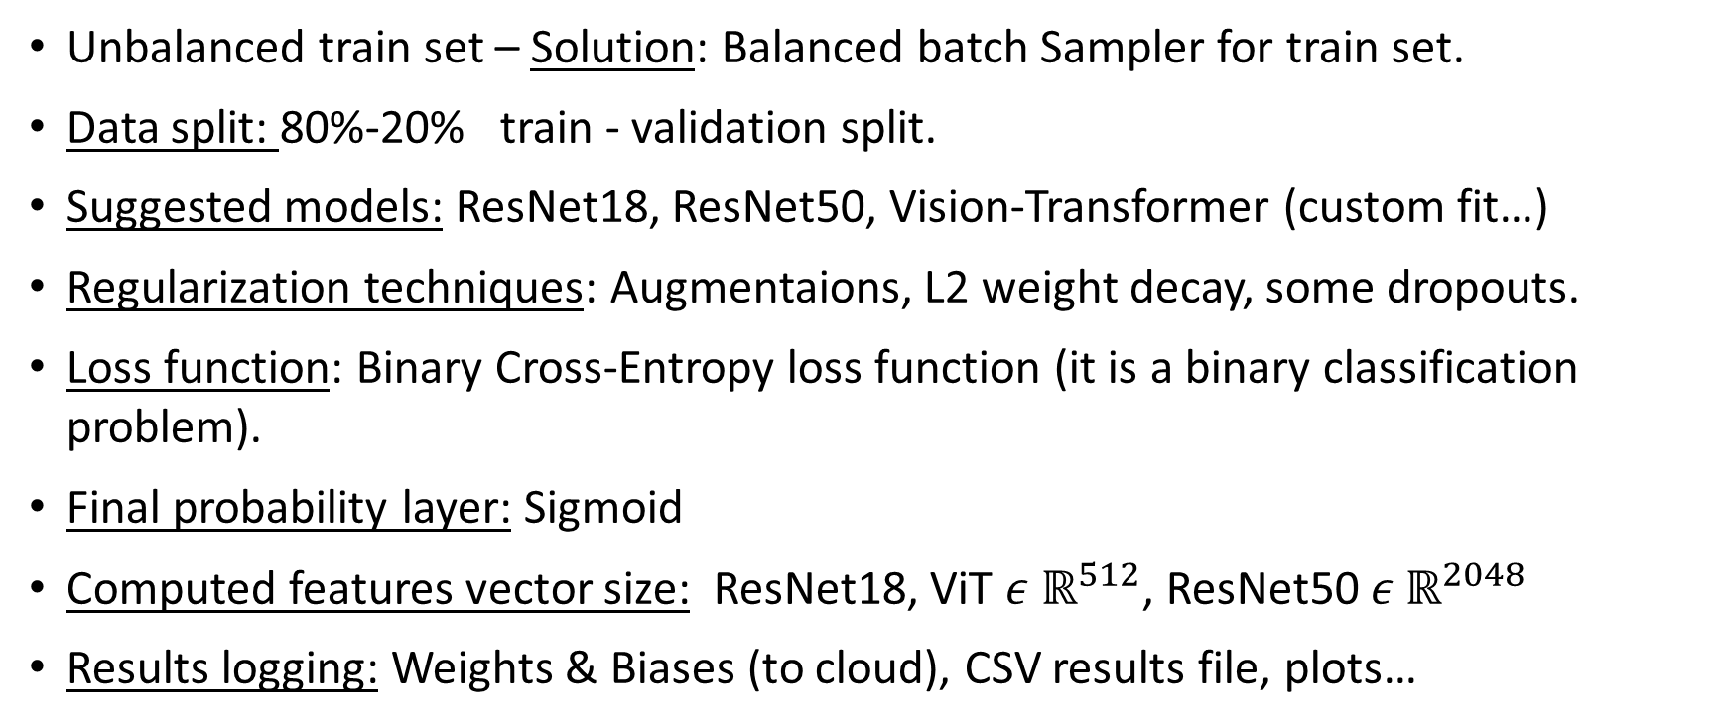
Solution approach
Unbalanced train set – Solution: Balanced batch Sampler for train set.
Data split: 80%-20% train - validation split.
Suggested models: ResNet18, ResNet50, Vision-Transformer (custom fit…)
Regularization techniques: Augmentaions, L2 weight decay, some dropouts.
Loss function: Binary Cross-Entropy loss function (it is a binary classification problem).
Final probability layer: Sigmoid
Computed features vector size: ResNet18, ViT $ε ℝ^{512}$, ResNet50 $ε ℝ^{2048}$
Results logging: Weights & Biases (to cloud), CSV results file, plots…

Slide 6
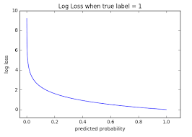
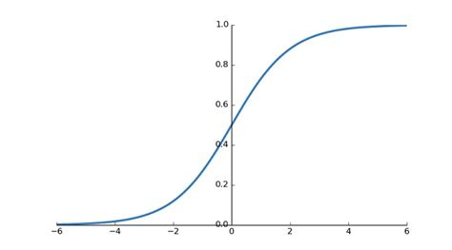
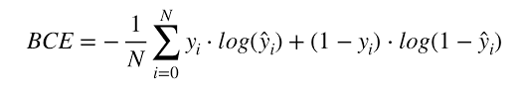
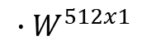
Block Diagram – ResNet18
Conv.1, 7x7
S=2,p=3
64
bn1
Relu
maxpool
Layer1 x2
20x20x3
10x10x64
5x5x64
5x5x64
logit
Layer2 x2
Layer3 x2
Layer4 x2
$${∙W}^{512x1}$$
1x1
3x3x128
2x2x256
Sigmoid
Features vector
1x1x512
Layer#:
Conv.1, 3x3
S=1,p=3
64
bn1
Relu
Conv.2, 3x3
S=1,p=1
64
bn2
+
Relu
5x5x64
5x5xX

Slide 7
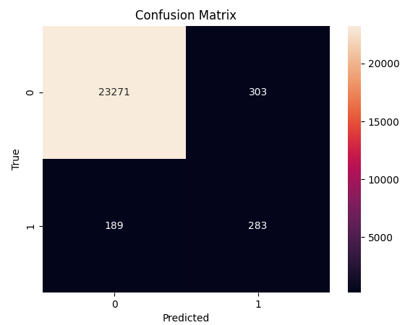
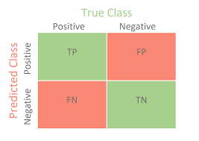
The way to the result
Initial step:
Train on ResNet18 with sigmoid and test results for 100 epochs and test results.
Not good enough – 189 FNs (40% of total positives) and 303 FPs.
Some thoughts:
Positives are rare in test-set → Let’s try not to miss any positive → Keep as few False Negatives as possible → maximize Recall/TPR. (TPR = TP / TP + FN).
What curves will emphasize the right information (or recall)?
1. Specificity – Sensitivity (TNR vs. TPR) curve (for all thresholds)
TNR = TN / TN + FP, TPR = TP / TP + FN
2. Balanced accuracy? Bal_acc = (TNR + TPR) / 2
3. Precision - Recall curve (for all thresholds)
PPV = TP / TP + FP, TPR = TP / TP + FN
4. Accuracy? Acc = TP + TN / all

Slide 8
Few more thoughts…
Sensitivity or recall/TPR - defined as the ratio between people correctly identified as having the disease by the amount of people actually having the disease (In our case – face is disease).
Specificity or TNR is defined as the ratio between people correctly identified as healthy by the amount of people that are actually healthy (In our case – non face).
I think it is more important (business-wise) not to miss any case of the disease than to detect it more precisely (although it is also important).
Higher thresholds increase

Slide 9
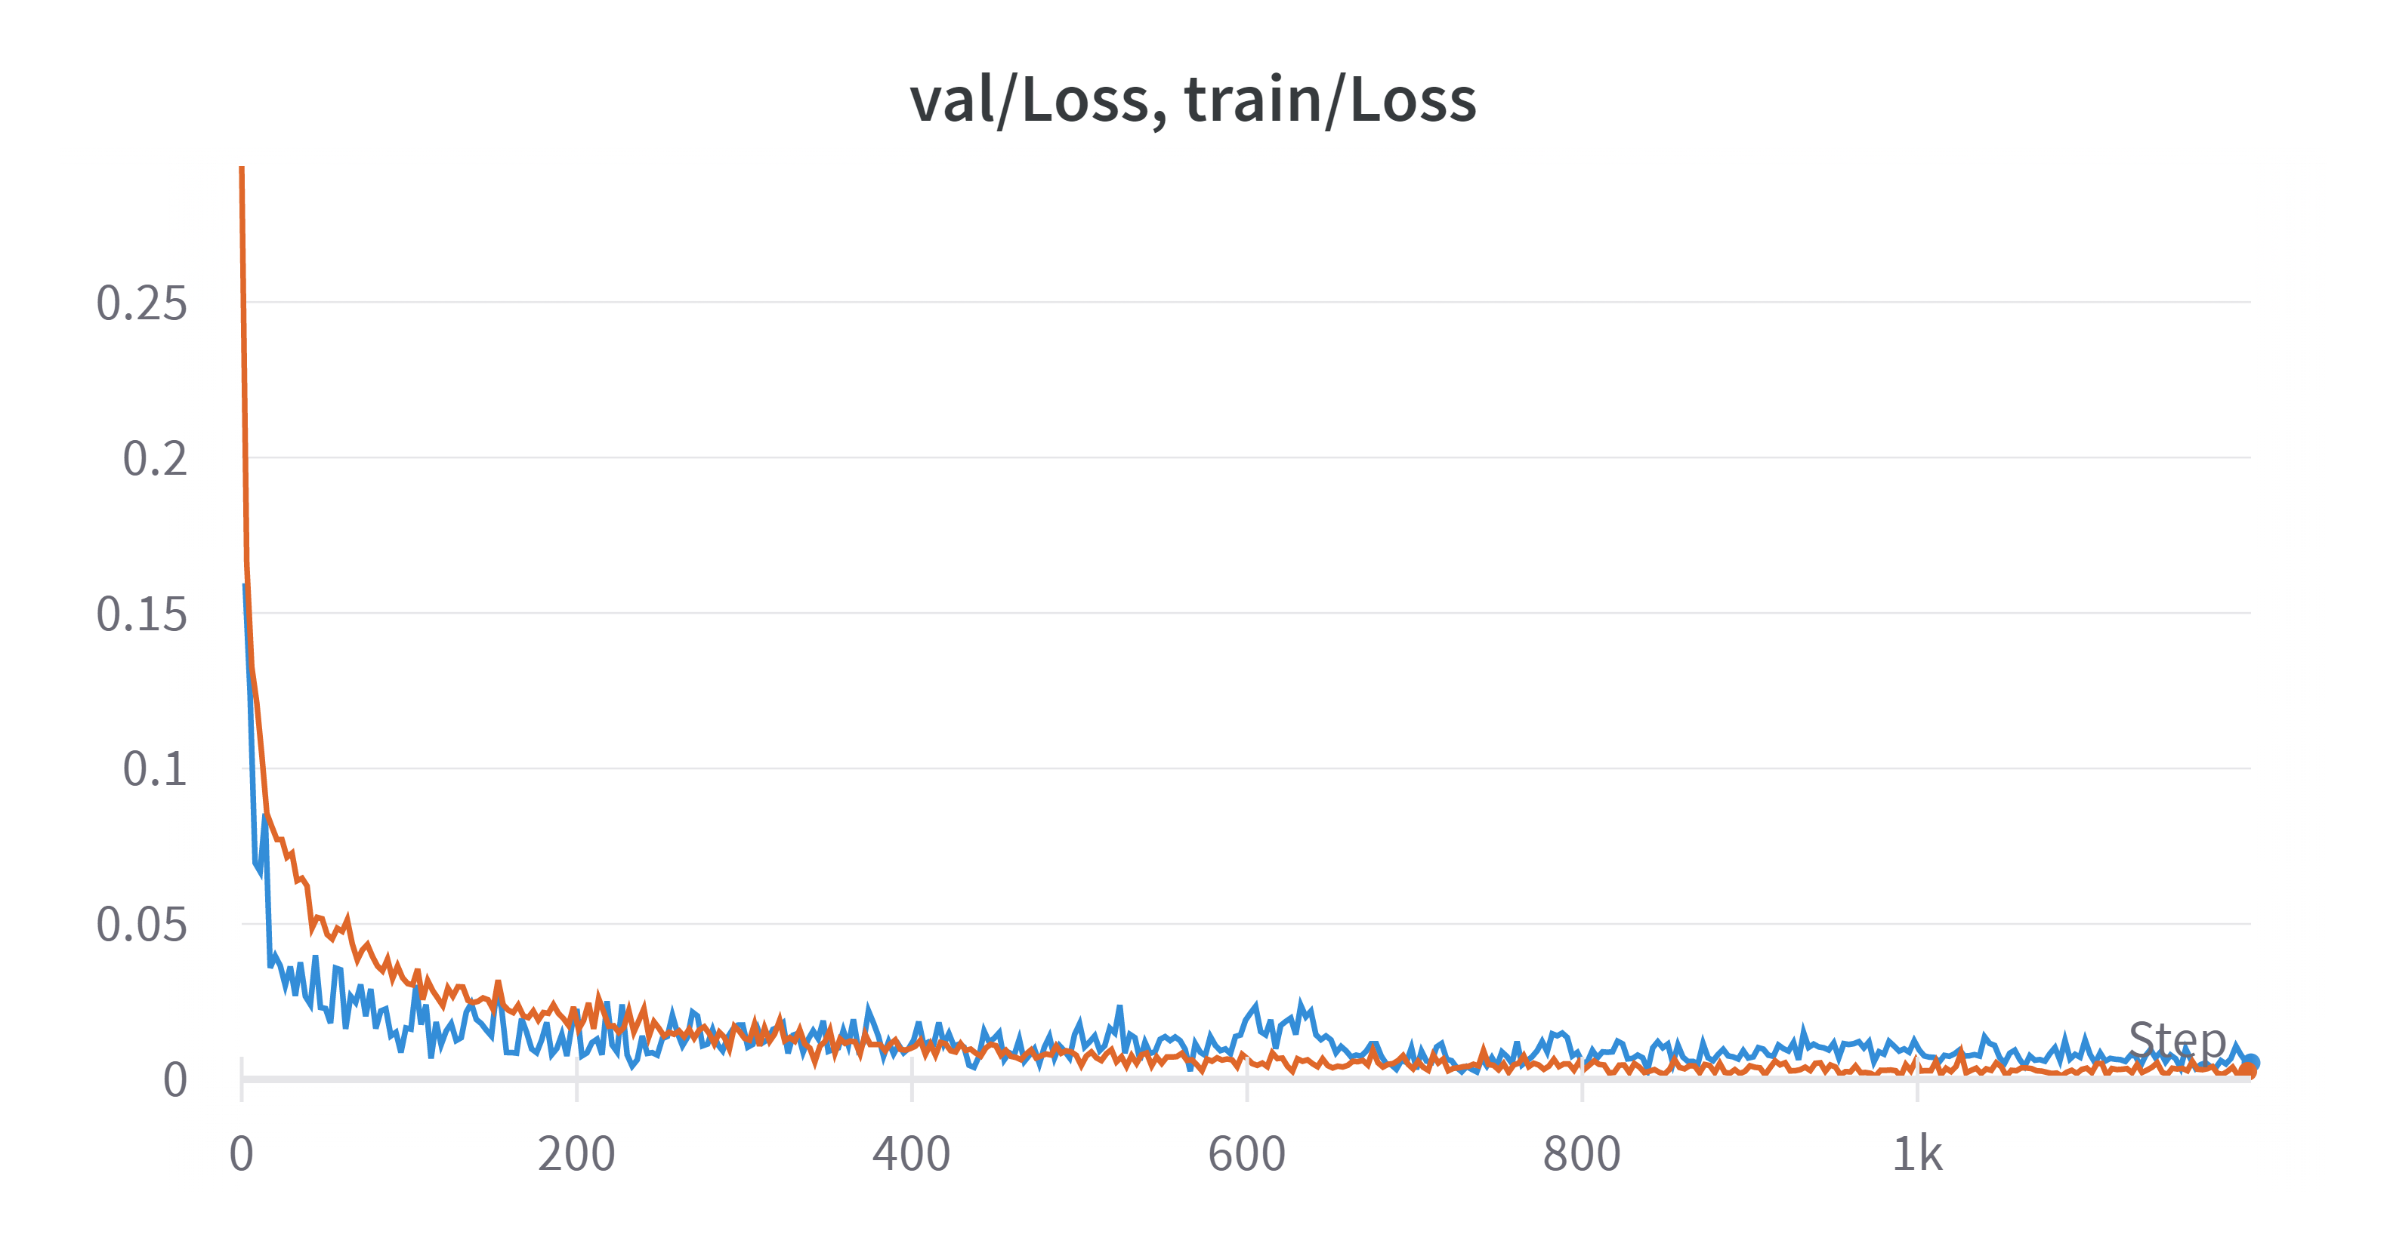
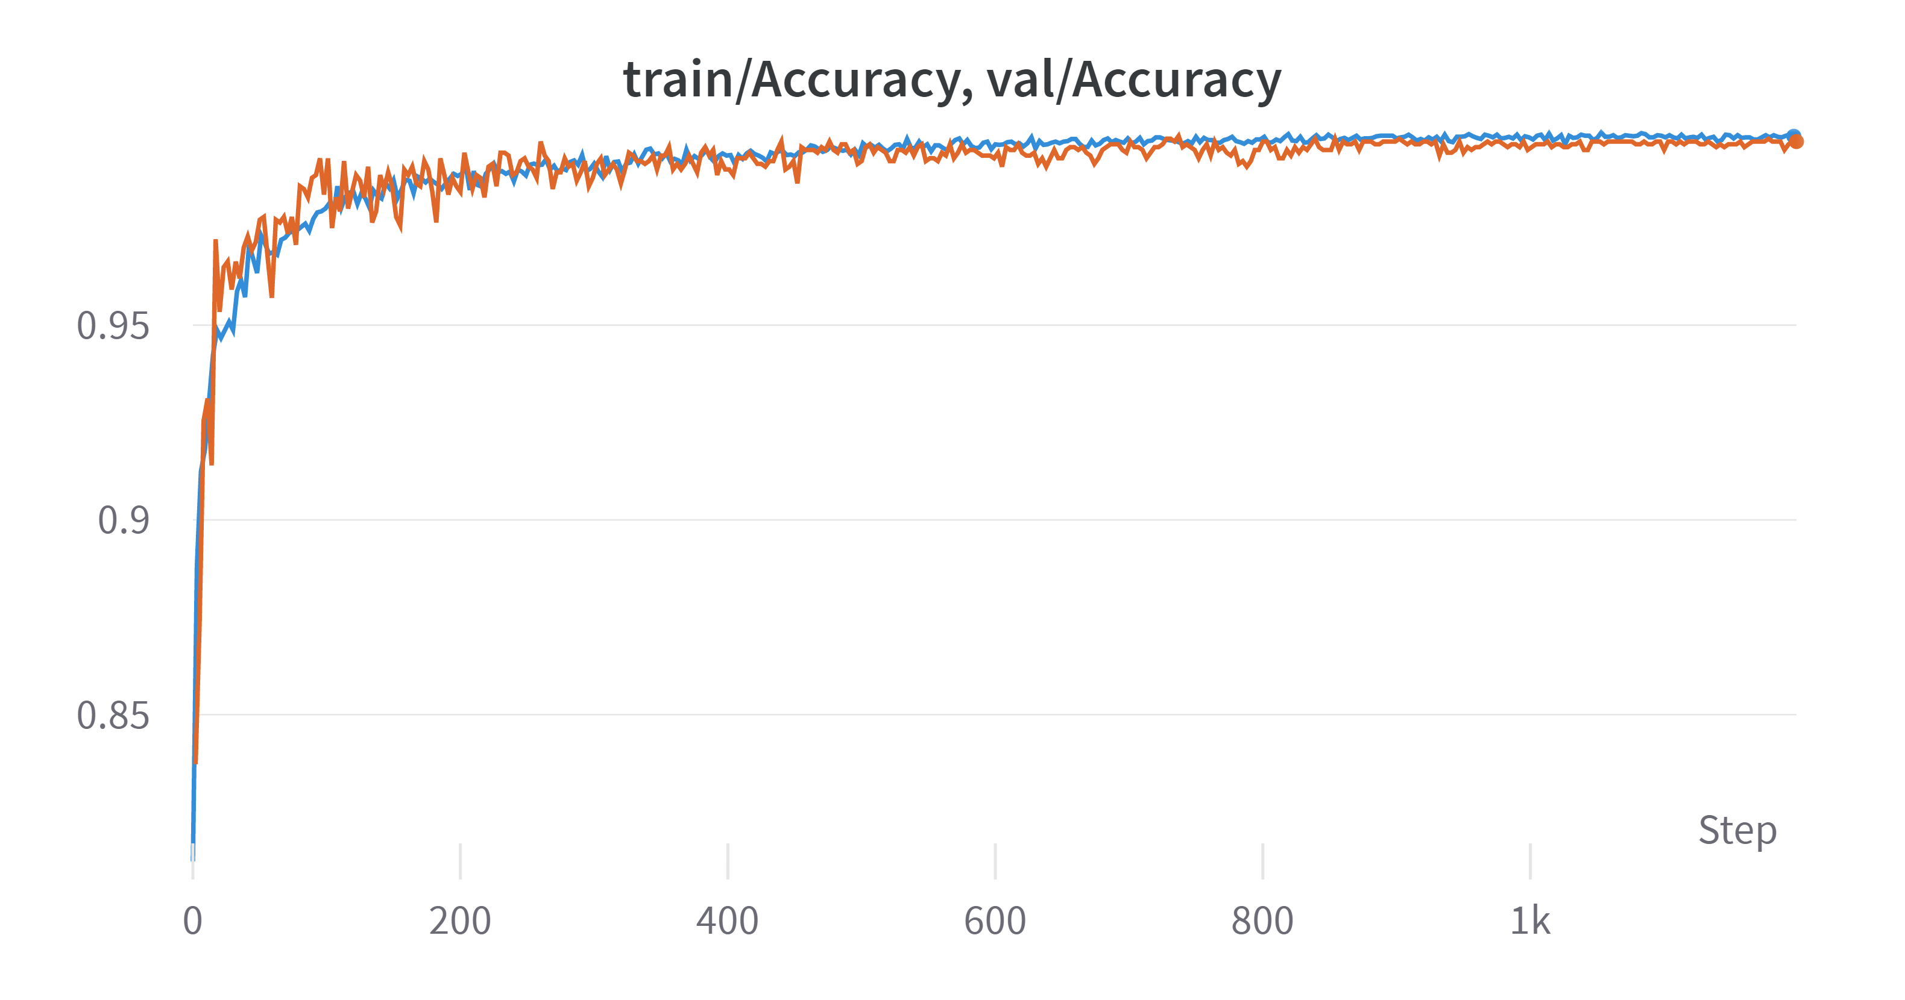
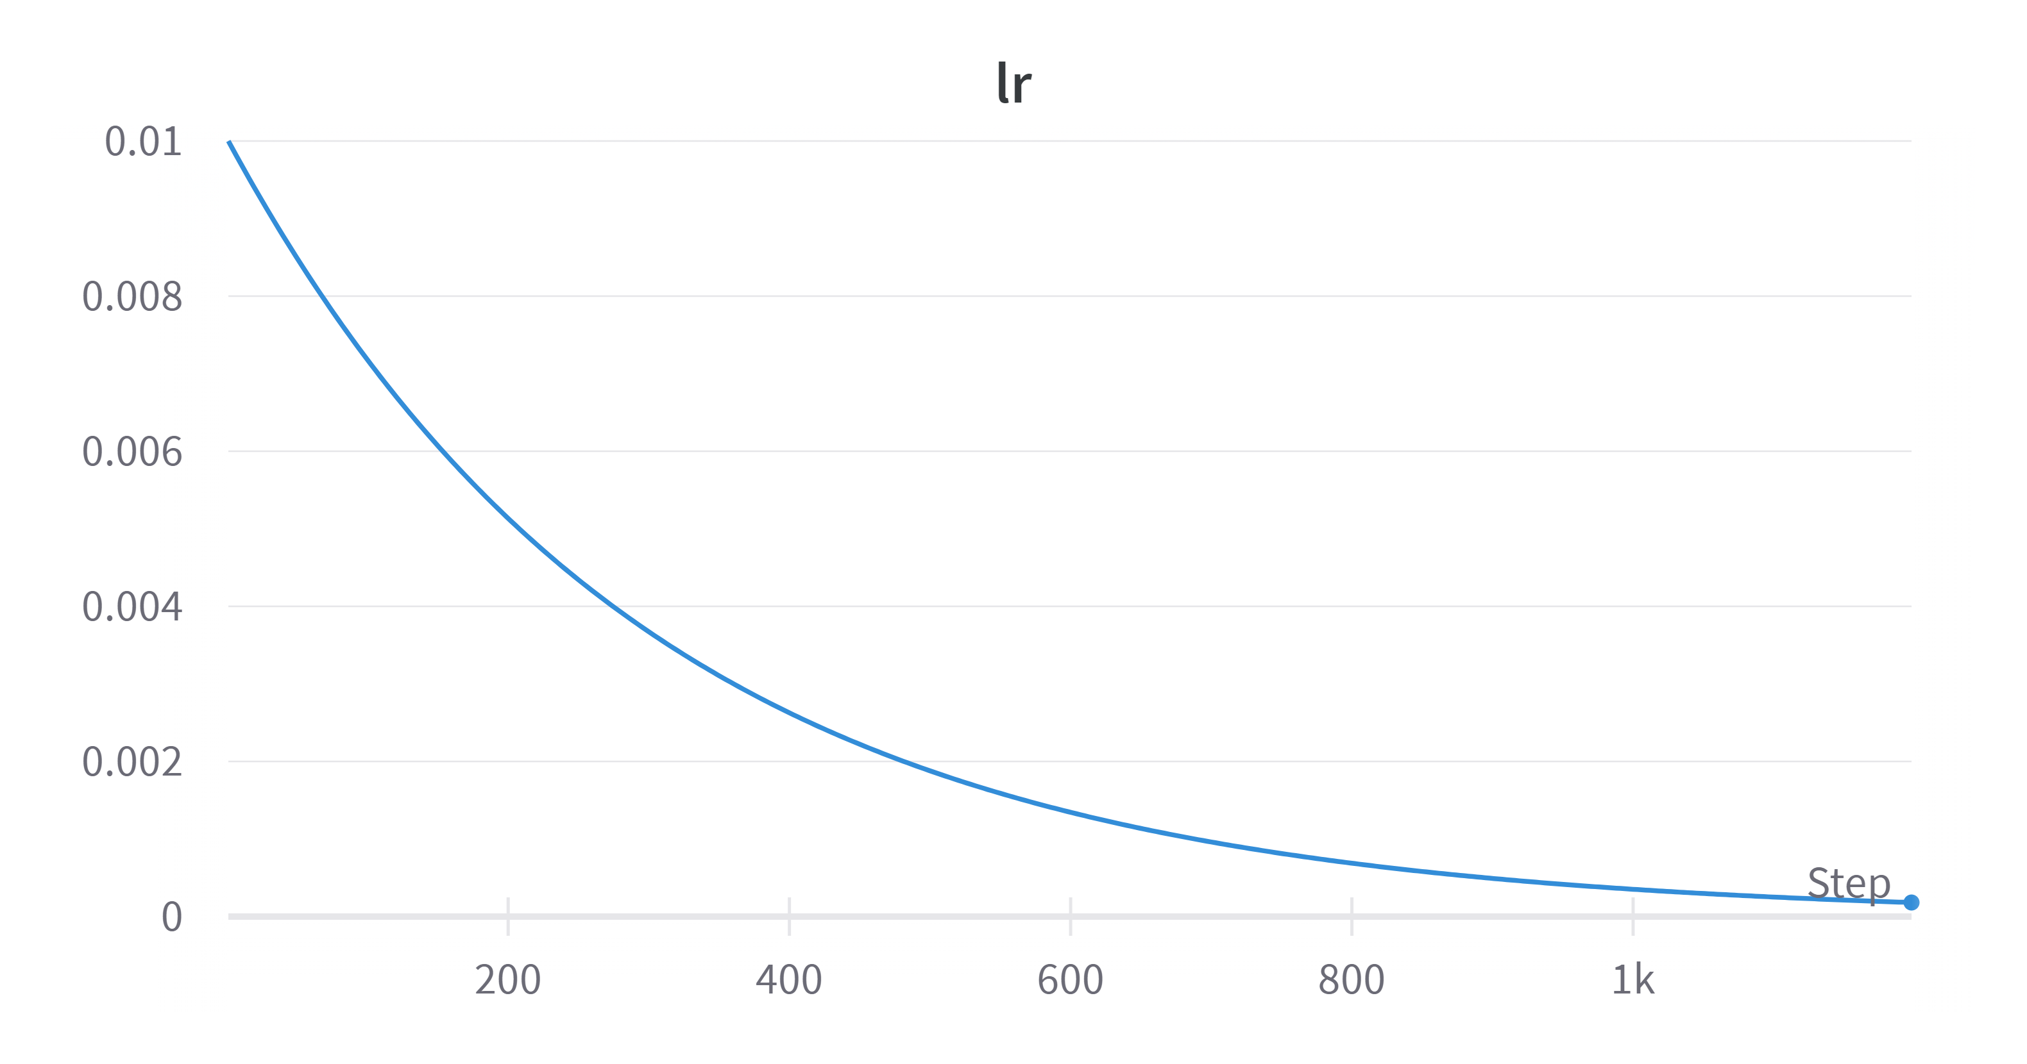
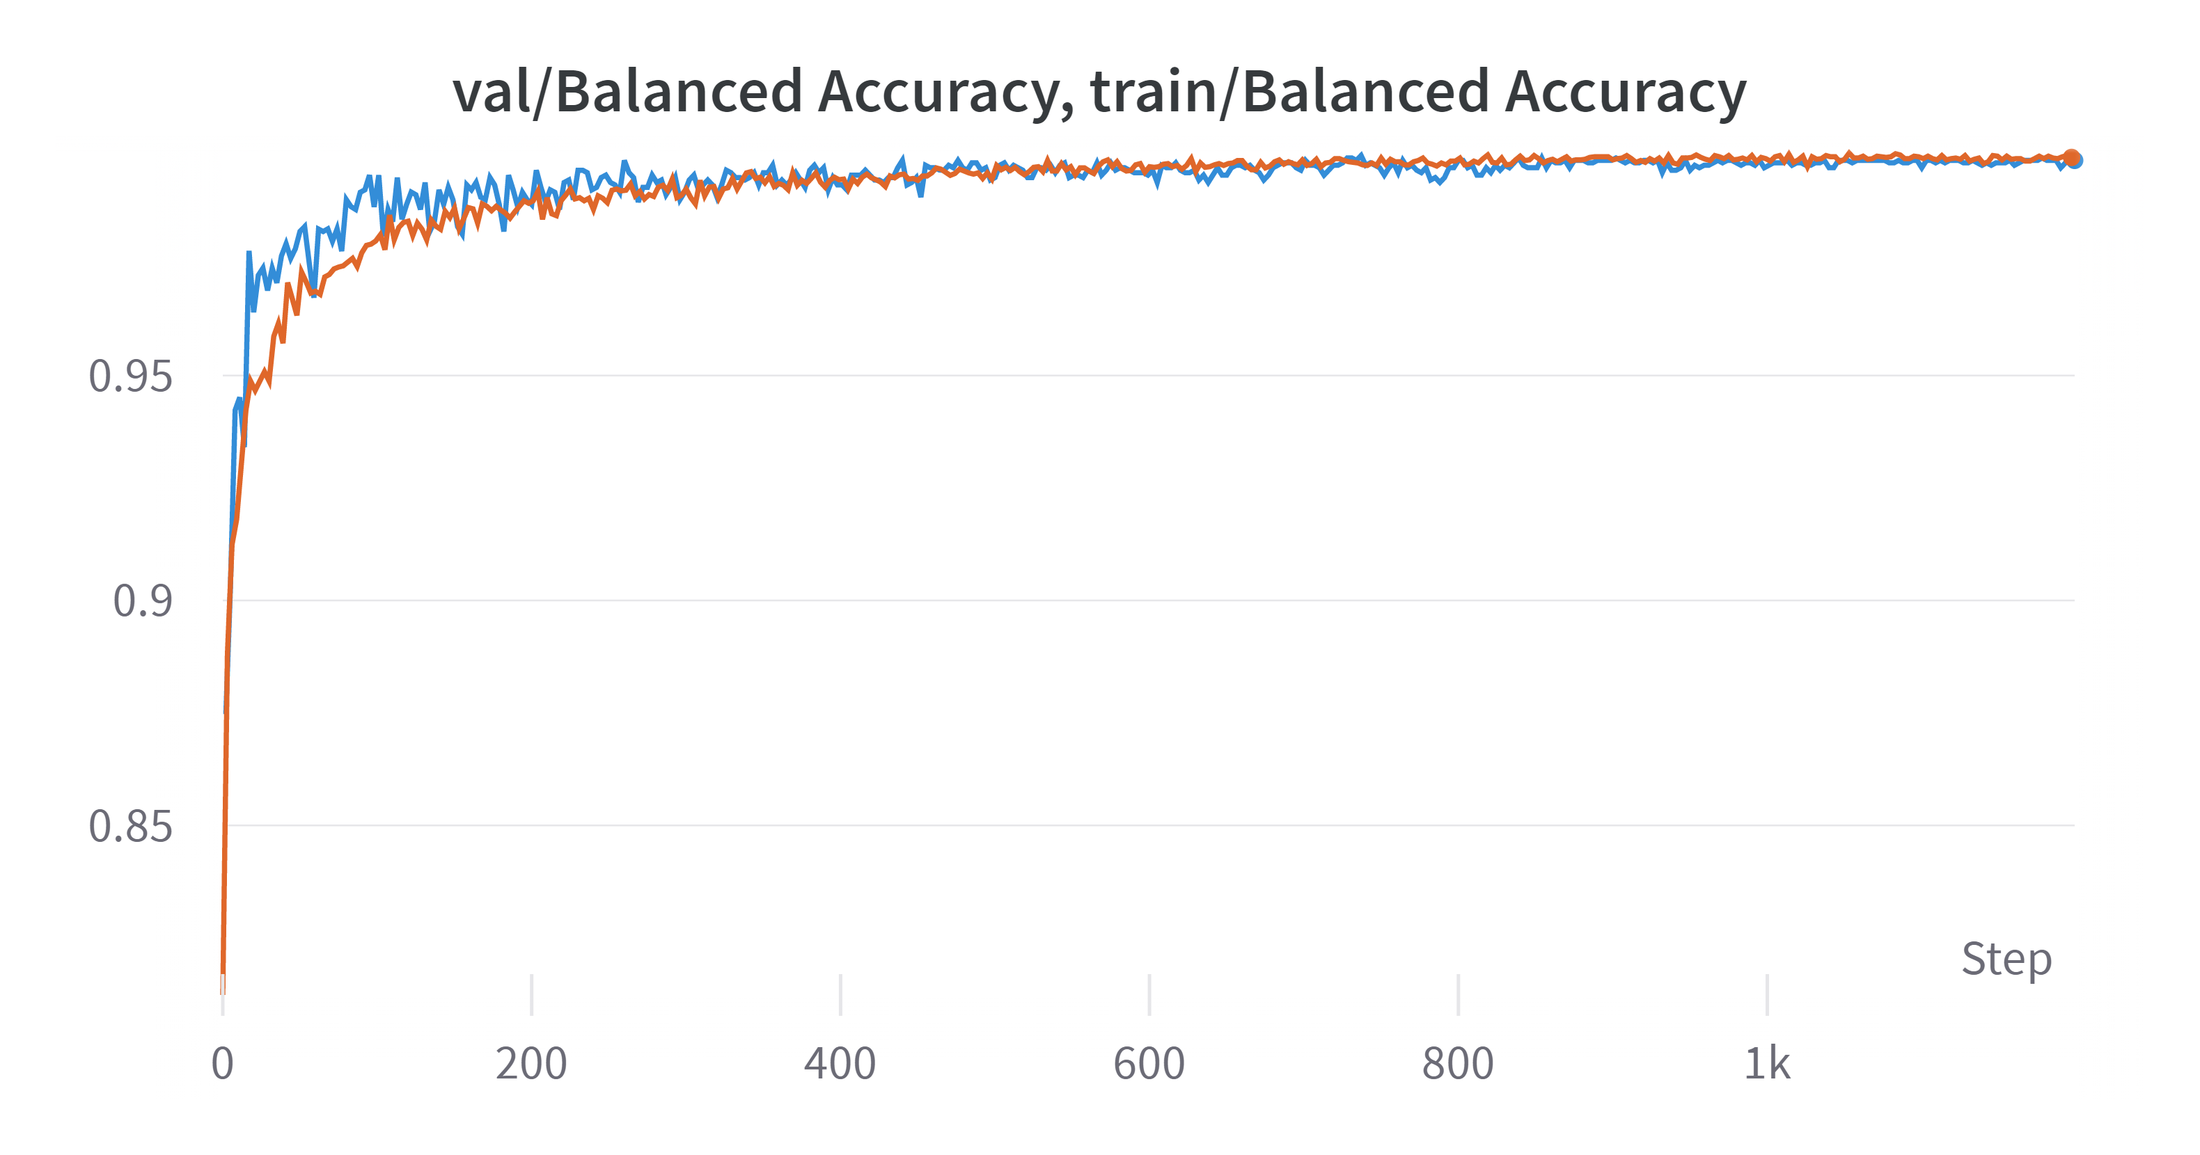
Train Results (1)
3 models were trained – ResNet18, ResNet50, ViT.
ResNet50:

Slide 10
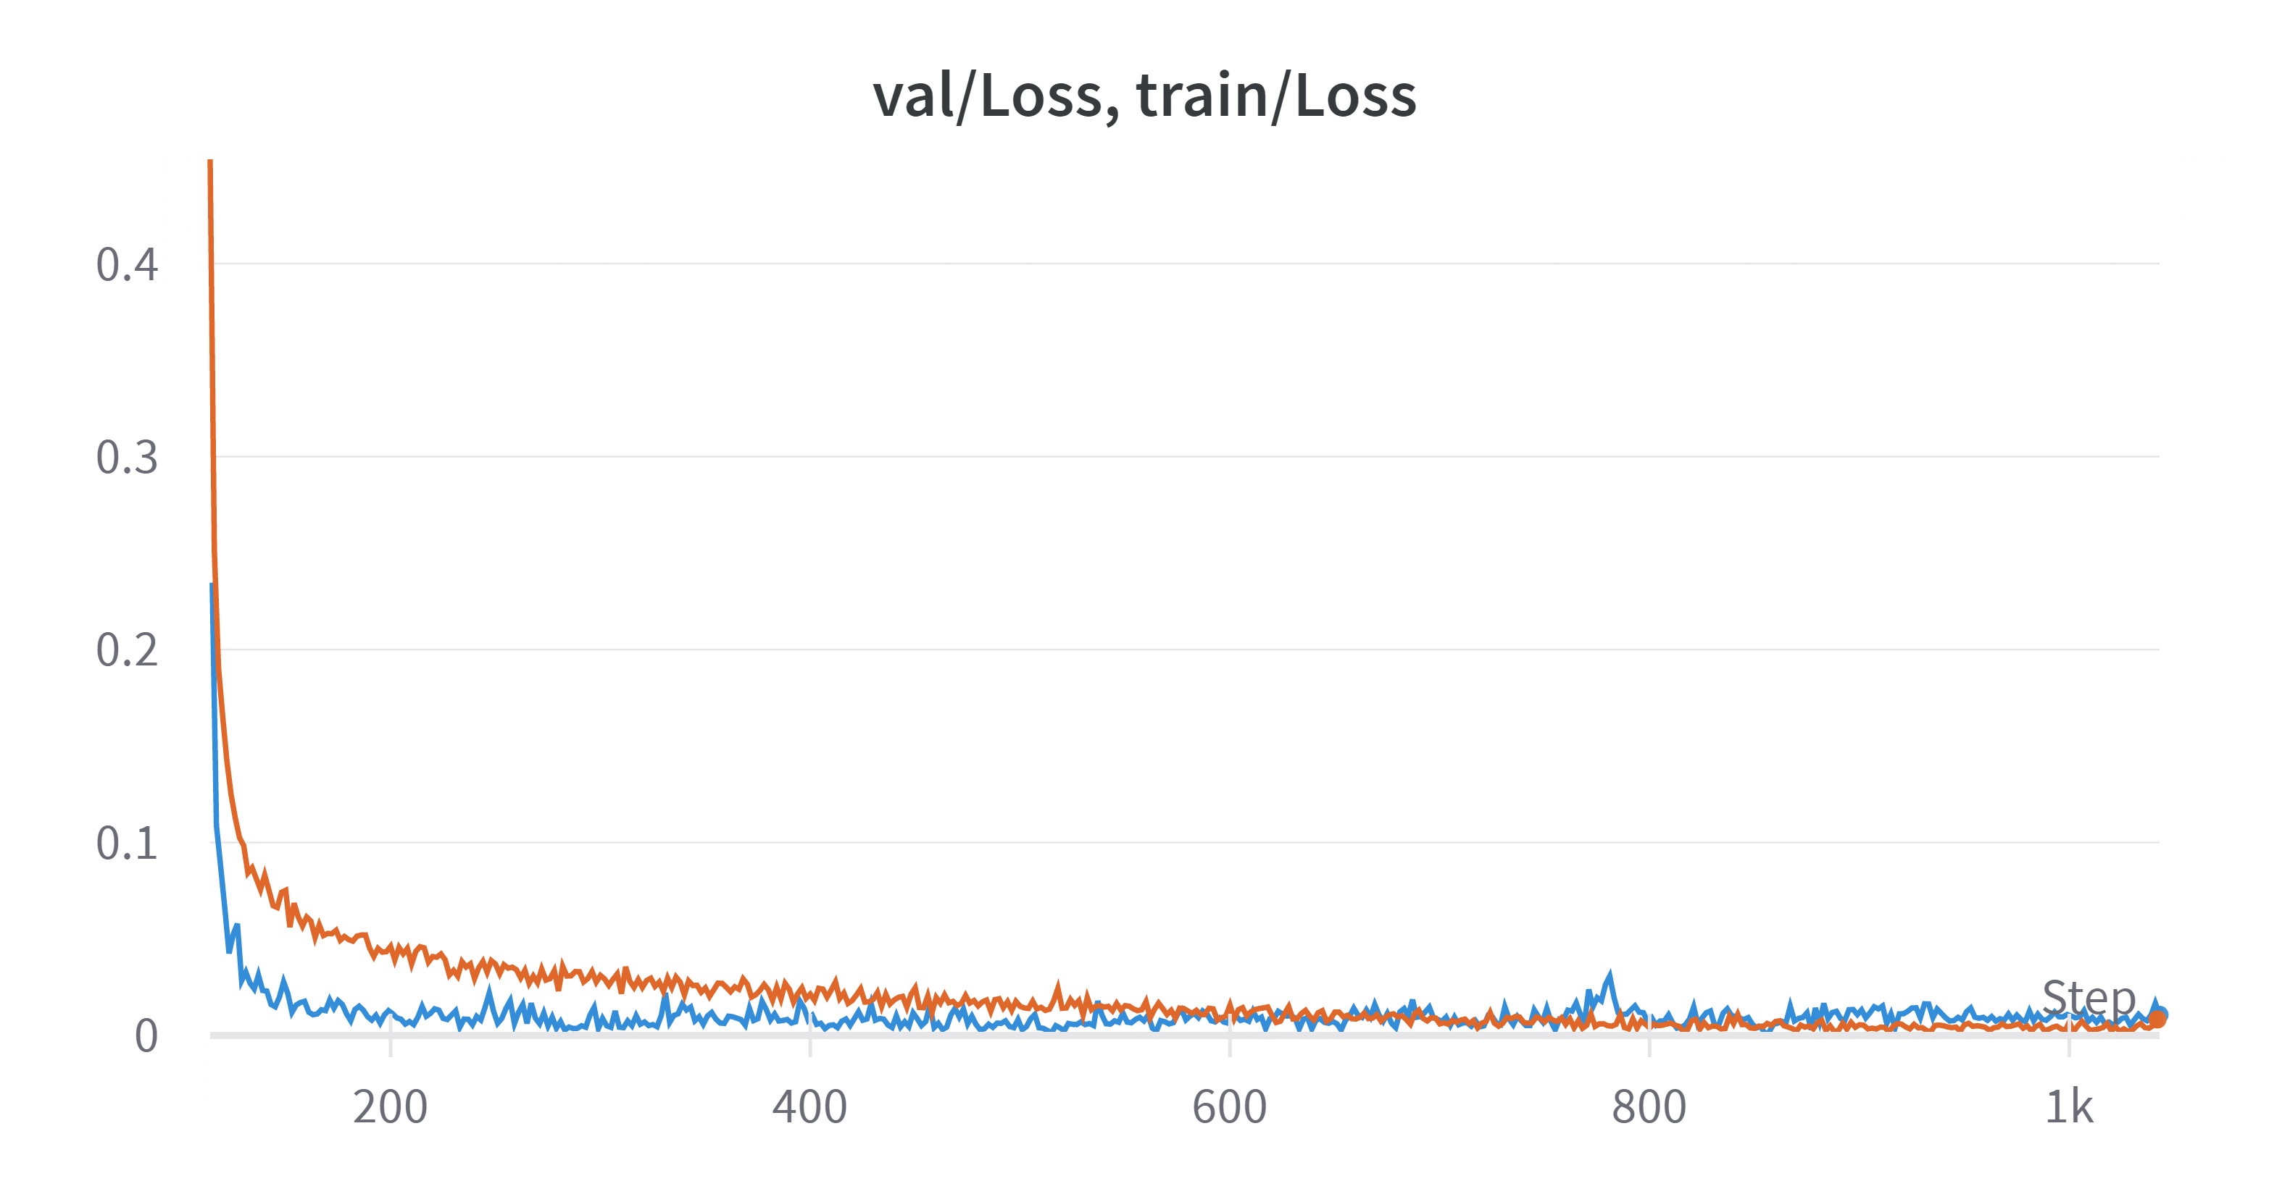
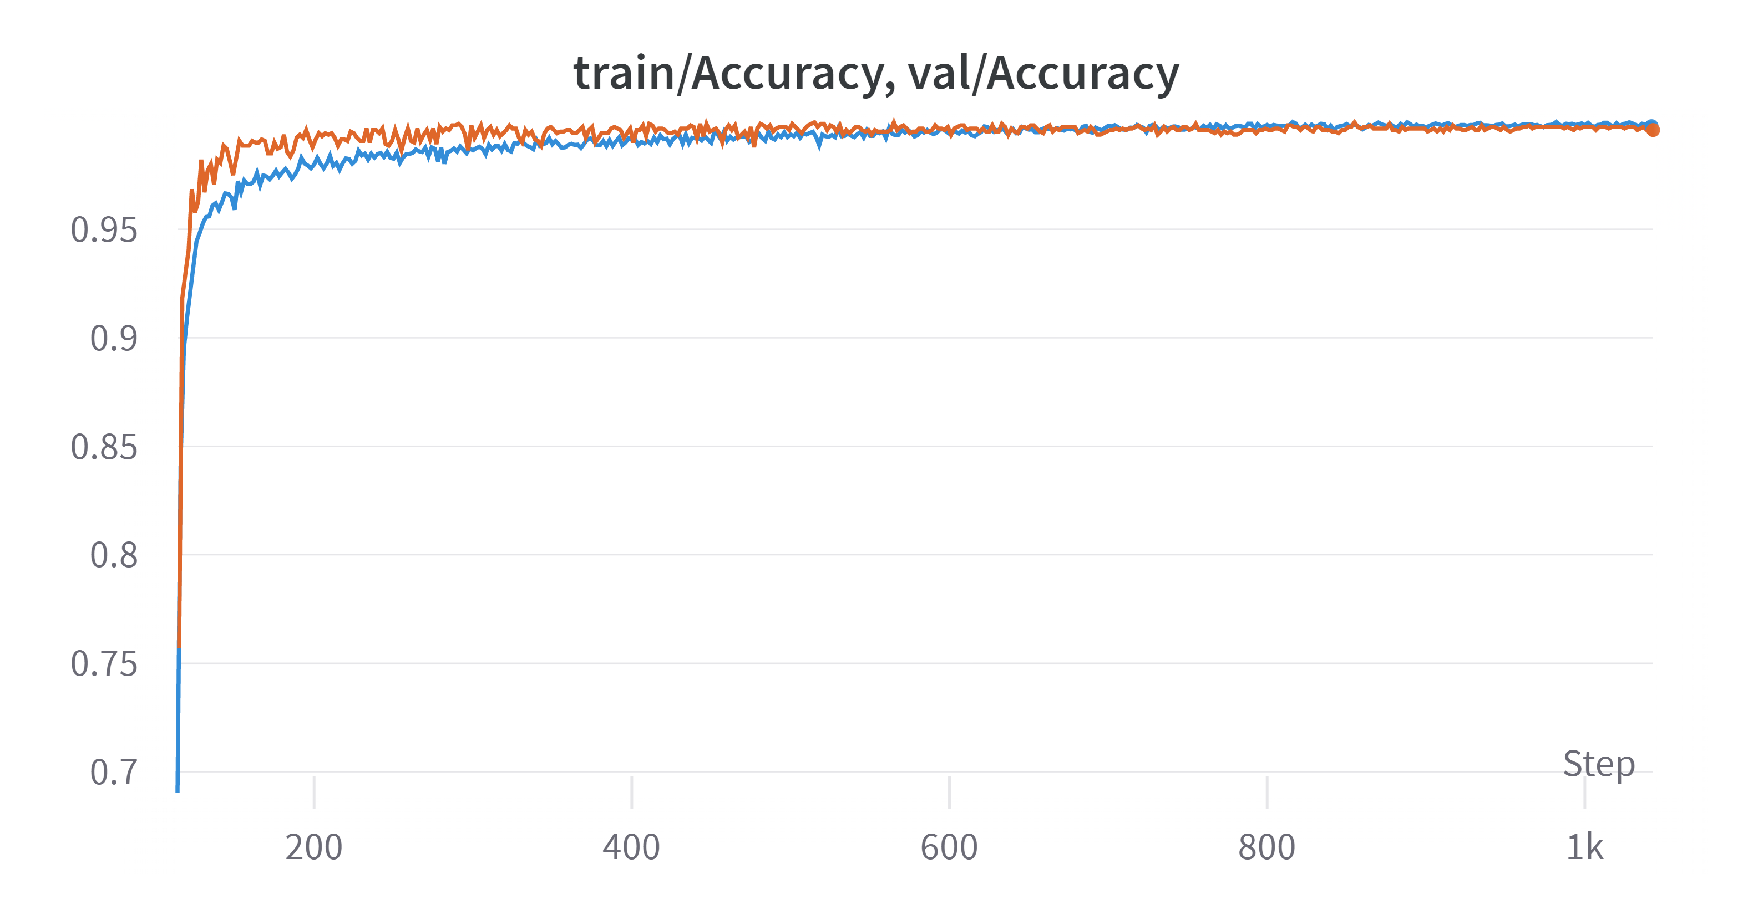
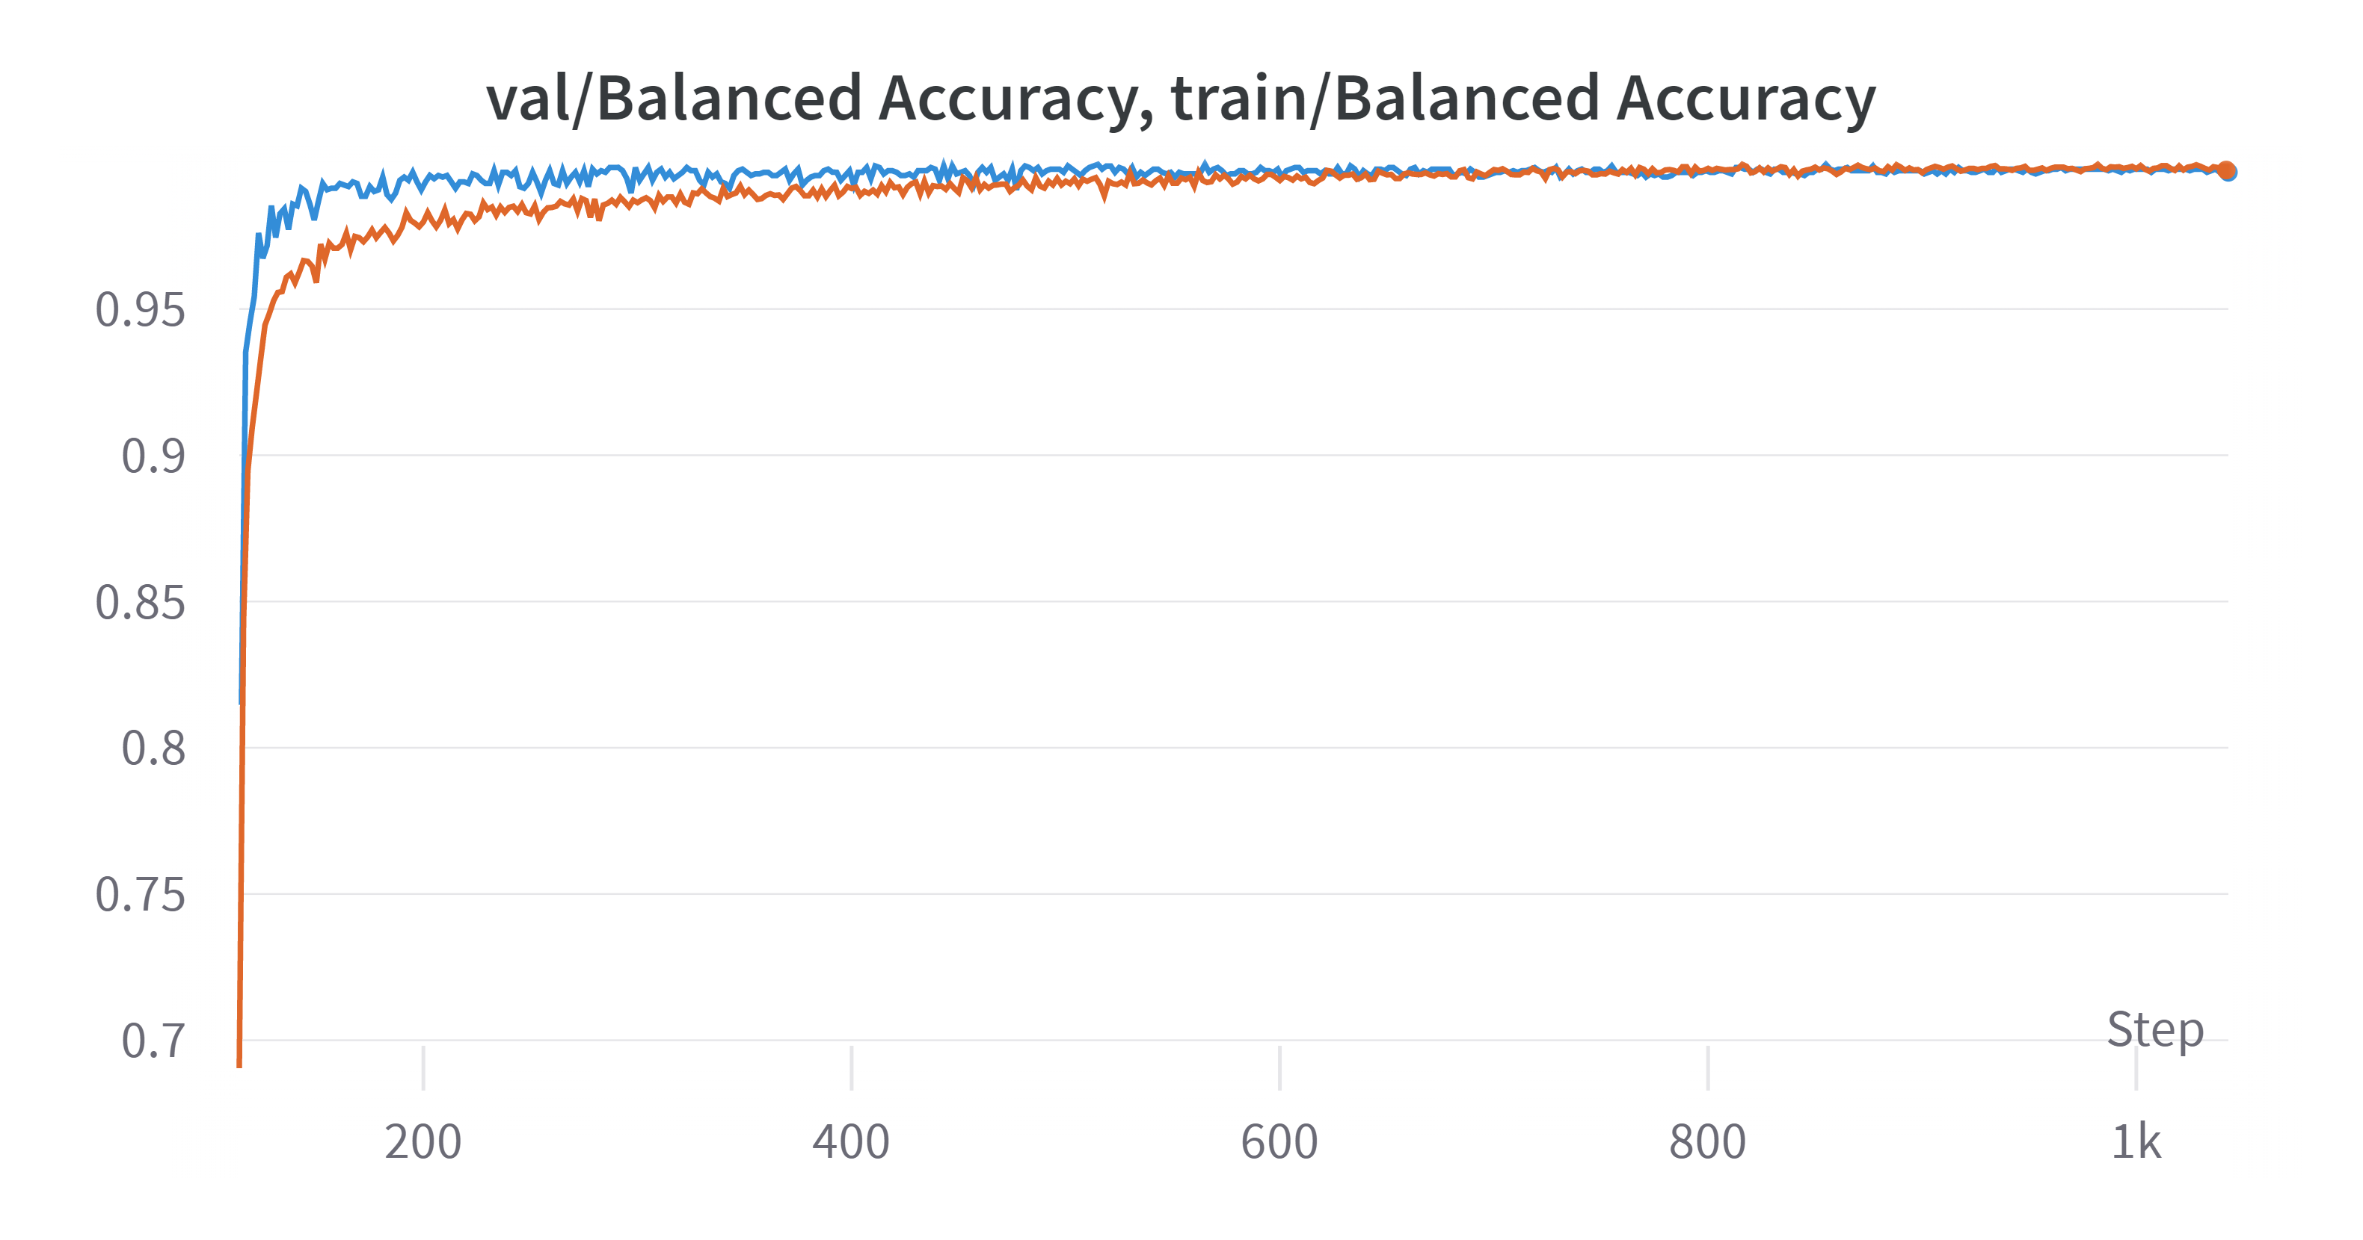
Train Results (2)
ResNet18:

Slide 11
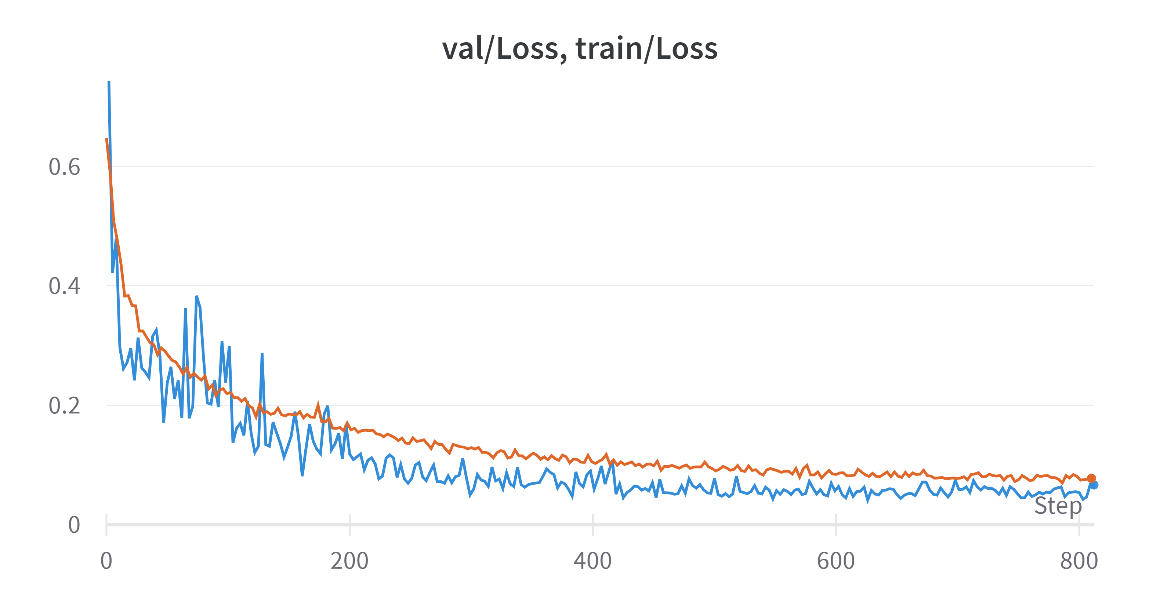
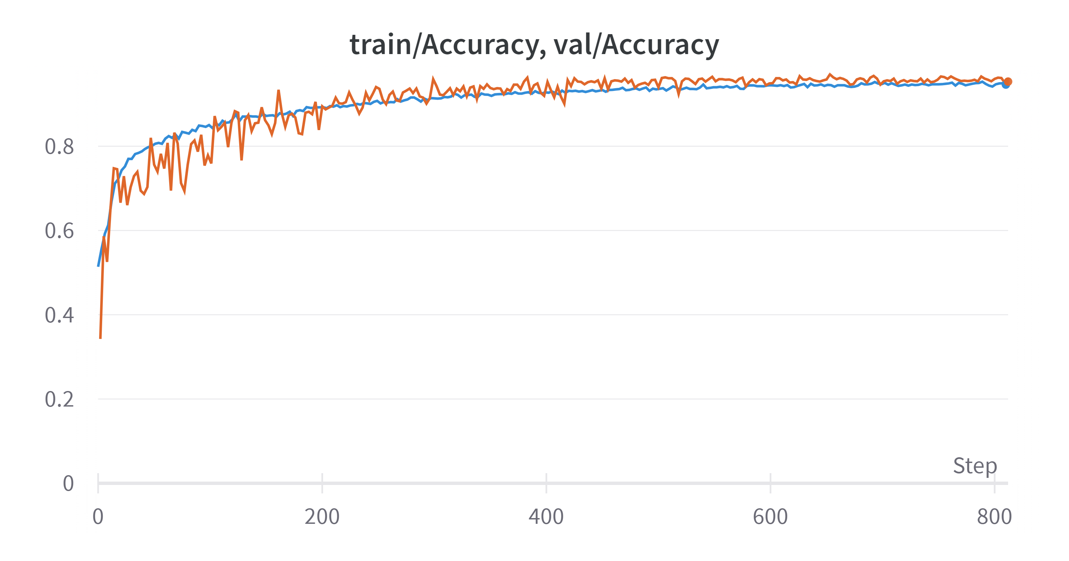
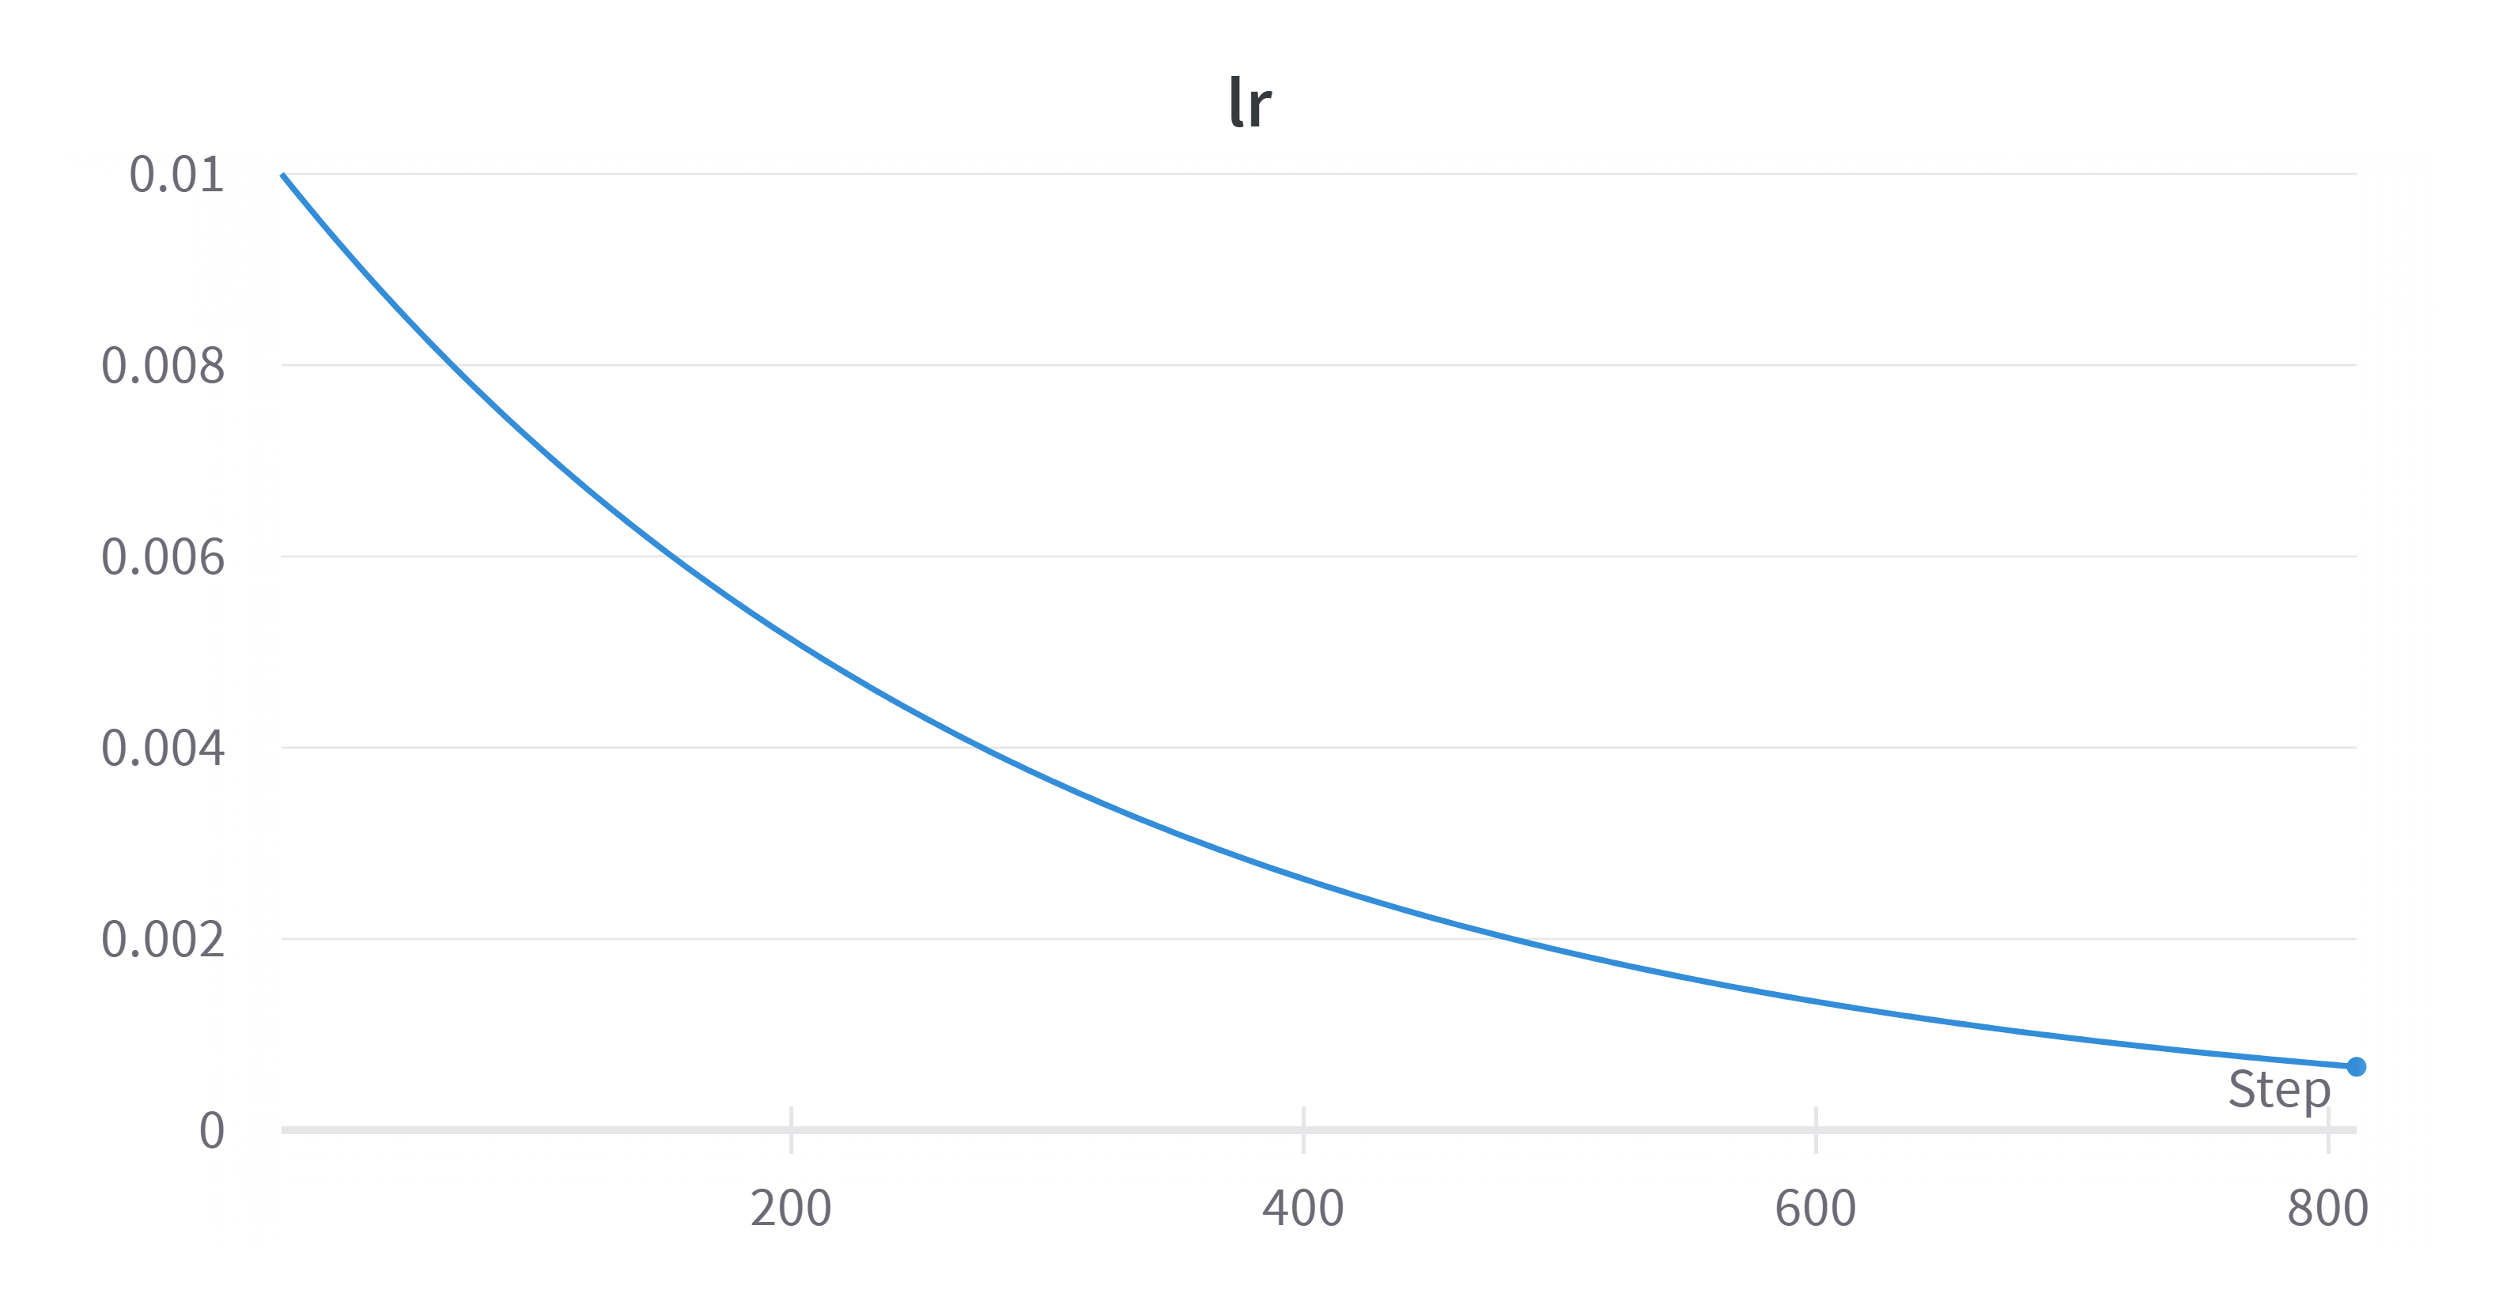
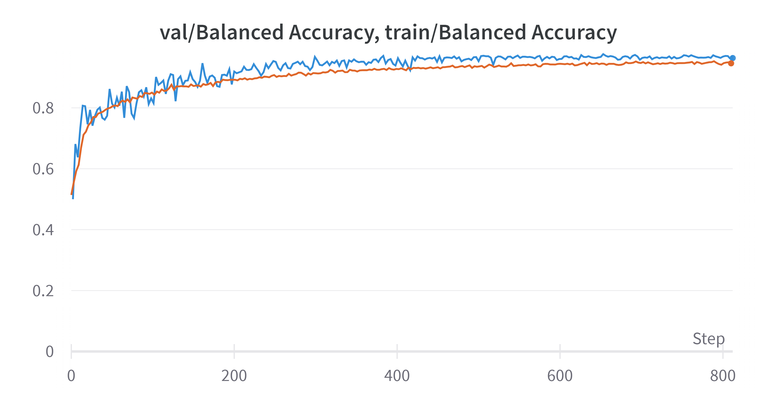
Train Results (3)
ViT:

Slide 12
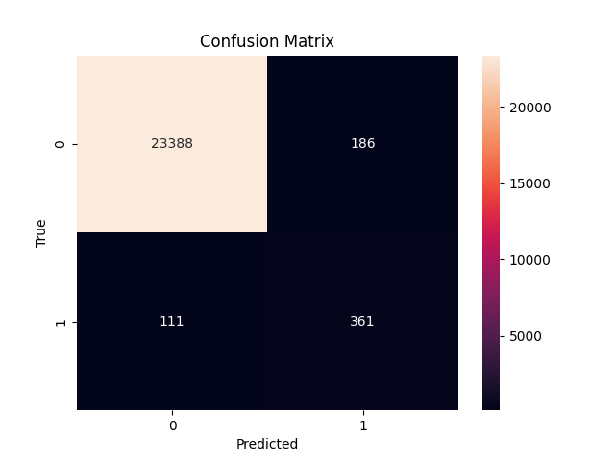



Classification metrics
TP = 361, FP = 186, FN = 111, TN = 23388
TPR = 361 / 361+111 = 76.5%.
TNR = 23388 / 23388+186 = 99.2%.
PPV = 66%
Accuracy = 98.7% , Balanced Accuracy = 87.85%

Slide 13














Mis-classifications analysis
ResNet50
Some FNs:
By using zoom-in and increasing blur in augmentations
we can perhaps reduce some FNs.
I did not notice smiles, nor angled faces therefore we should add this data to reduce this kind of FNs
Some FPs:
I noticed 3 types of FPs – distant faces, letters and amorphic patterns.
The amorphic patterns are perhaps easiest to deal with by some more regularization
Distant faces are incorrect therefore we should limit zoom-out augmentations, are add some distant face to the data.
We can add letters and sentences to the train set and also reduce these mistakes.

Slide 14




Visualization of the computed features
ResNet50, test sigmoid threshold 0.5:
I would have tried to analyze the points of the main spread in the lower left corner of the FN plot → try to look for similarities in those samples.
I assume the outliers are somehow more difficult to tackle, but it also worths a check. Perhaps there is some pattern.
FPs are also difficult to solve because they behave similarly to TPS, but an outliers check is necessary.

Slide 15
What would I do next
Analyze mis-classification of the validation-set FNs and FPs for best epoch.
Look for similarities in FNs and FPs in test-set.
Analyze outliers in PCA - in FN and FP. Also examine clusters on FNs.
Add to train set information which only exists in test-set like letters, sentences, negative examples of far faces. Positive examples of smiles and tilted faces.
Improve augmentations (to test-set FNs).
Explore architectures, models and ideas to improve results.

Slide 16
Vision Transformer

Slide 17
Appendix
Project repo on Github -
https://github.com/noamberg/face_non-face
2. W&B logs – Losses, accuracies and learning rates –
https://wandb.ai/noamberg/face_non-faces?workspace=user-noamberg
3. Trained weights -
https://drive.google.com/file/d/1emREHRBzQBTID8jmjocqqOq7S-St9BSo/view?usp=share_link

Slide 18

Thanks!

